Slide 1
Chapter 3
Digital Design and Computer Architecture: ARM® Edition
Sarah L. Harris and David Money Harris

Slide 2
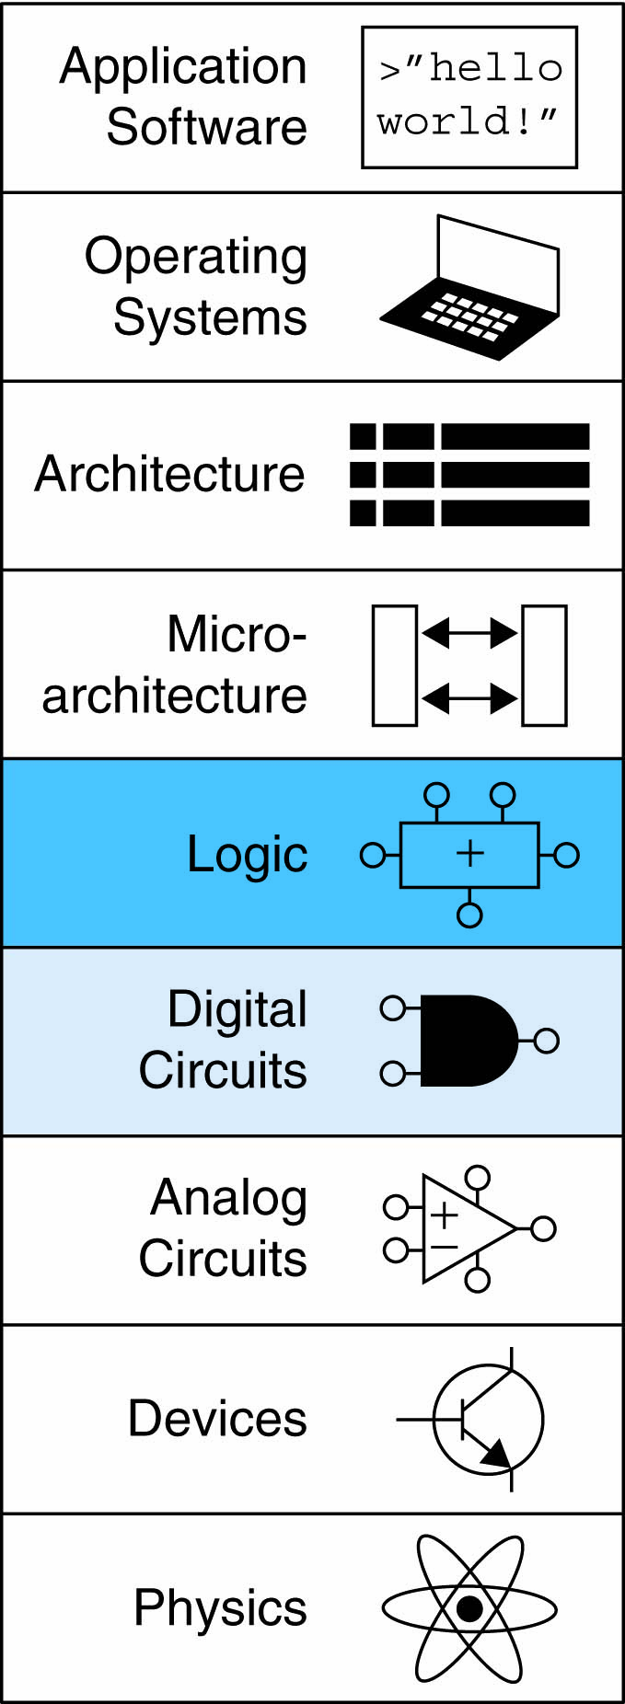
Chapter 3 :: Topics
Introduction
Latches and Flip-Flops
Synchronous Logic Design
Finite State Machines
Timing of Sequential Logic
Parallelism

Slide 3
Introduction
Outputs of sequential logic depend on current and prior input values – it has memory.
Some definitions:
State: all the information about past inputs necessary to explain its future behavior
Latches and flip-flops: state elements that store one bit of state
Synchronous sequential circuits: combinational logic followed by a bank of flip-flops

Slide 4
Sequential Circuits
Give sequence to events
Have memory (short-term)
Use feedback from output to input to store information

Slide 5
State Elements
The state of a circuit influences its future behavior
State elements store state
Bistable circuit
SR Latch
D Latch
D Flip-flop

Slide 6
Bistable Circuit
Fundamental building block of other state elements
Two outputs: Q, Q
No inputs

Slide 7
Bistable Circuit Analysis
Consider the two possible cases:
Q = 0:
then Q = 0, Q = 1 (consistent)
Q = 1:
then Q = 1, Q = 0 (consistent)
Stores 1 bit of state in the state variable, Q (or Q)
But there are no inputs to control the state

Slide 8
SR (Set/Reset) Latch
SR Latch
Consider the four possible cases:
S = 1, R = 0
S = 0, R = 1
S = 0, R = 0
S = 1, R = 1

Slide 9
SR Latch Analysis
S = 1, R = 0:
then Q = 1 and Q = 0
Set the output
S = 0, R = 1:
then Q = 0 and Q = 1
Reset the output
1
1

Slide 10
SR Latch Analysis
S = 0, R = 0:
then Q = Q_{prev}
Memory!
S = 1, R = 1:
then Q = 0, Q = 0
Invalid State
Q ≠ NOT Q
1

Slide 11
SR Latch Symbol
SR stands for Set/Reset Latch
Stores one bit of state (Q)
Control what value is being stored with S, R inputs
Set: Make the output 1
(S = 1, R = 0, Q = 1)
Reset: Make the output 0
(S = 0, R = 1, Q = 0)
Avoid invalid state
(when S = R = 1)

Slide 12
D Latch
Two inputs: CLK, D
CLK: controls when the output changes
D (the data input): controls what the output changes to
Function
When CLK = 1,
D passes through to Q (transparent)
When CLK = 0,
Q holds its previous value (opaque)
Avoids invalid case when
Q ≠ NOT Q

Slide 13
D Latch Internal Circuit

Slide 14
D Flip-Flop
Inputs: CLK, D
Function
Samples D on rising edge of CLK
When CLK rises from 0 to 1, D passes through to Q
Otherwise, Q holds its previous value
Q changes only on rising edge of CLK
Called edge-triggered
Activated on the clock edge

Slide 15
D Flip-Flop Internal Circuit
Two back-to-back latches (L1 and L2) controlled by complementary clocks
When CLK = 0
L1 is transparent
L2 is opaque
D passes through to N1
When CLK = 1
L2 is transparent
L1 is opaque
N1 passes through to Q
Thus, on the edge of the clock (when CLK rises from 0 1)
D passes through to Q

Slide 16
D Latch vs. D Flip-Flop

Slide 17
Registers: Multi-bit Flip-Flop

Slide 18
Enabled Flip-Flops
Inputs: CLK, D, EN
The enable input (EN) controls when new data (D) is stored
Function
EN = 1: D passes through to Q on the clock edge
EN = 0: the flip-flop retains its previous state

Slide 19
Resettable Flip-Flops
Inputs: CLK, D, Reset
Function:
Reset = 1: Q is forced to 0
Reset = 0: flip-flop behaves as ordinary D flip-flop

Slide 20
Resettable Flip-Flops
Two types:
Synchronous: resets at the clock edge only
Asynchronous: resets immediately when Reset = 1
Asynchronously resettable flip-flop requires changing the internal circuitry of the flip-flop
Synchronously resettable flip-flop?

Slide 21
Resettable Flip-Flops
Two types:
Synchronous: resets at the clock edge only
Asynchronous: resets immediately when Reset = 1
Asynchronously resettable flip-flop requires changing the internal circuitry of the flip-flop
Synchronously resettable flip-flop

Slide 22
Settable Flip-Flops
Inputs: CLK, D, Set
Function:
Set = 1: Q is set to 1
Set = 0: the flip-flop behaves as ordinary D flip-flop

Slide 23
Sequential Logic
Sequential circuits: all circuits that aren’t combinational
A problematic circuit:
No inputs and 1-3 outputs
Astable circuit, oscillates
Period depends on inverter delay
It has a cyclic path: output fed back to input

Slide 24
Synchronous Sequential Logic Design
Breaks cyclic paths by inserting registers
Registers contain state of the system
State changes at clock edge: system synchronized to the clock
Rules of synchronous sequential circuit composition:
Every circuit element is either a register or a combinational circuit
At least one circuit element is a register
All registers receive the same clock signal
Every cyclic path contains at least one register
Two common synchronous sequential circuits
Finite State Machines (FSMs)
Pipelines

Slide 25
Finite State Machine (FSM)
Consists of:
State register
Stores current state
Loads next state at clock edge
Combinational logic
Computes the next state
Computes the outputs

Slide 26
Finite State Machines (FSMs)
Next state determined by current state and inputs
Two types of finite state machines differ in output logic:
Moore FSM: outputs depend only on current state
Mealy FSM: outputs depend on current state and inputs

Slide 27
FSM Design Procedure
Identify inputs and outputs
Sketch state transition diagram
Write state transition table
Select state encodings
For Moore machine:
Rewrite state transition table with state encodings
Write output table
5. For a Mealy machine:
Rewrite combined state transition and output table with state encodings
6. Write Boolean equations for next state and output logic
7. Sketch the circuit schematic

Slide 28
FSM Example
Traffic light controller
Traffic sensors: T_{A}, T_{B} (TRUE when there’s traffic)
Lights: L_{A}, L_{B}

Slide 29
FSM Black Box
Inputs: CLK, Reset, T_{A}, T_{B}
Outputs: L_{A}, L_{B}

Slide 30
FSM State Transition Diagram
Moore FSM: outputs labeled in each state
States: Circles
Transitions: Arcs

Slide 31
FSM State Transition Diagram
Moore FSM: outputs labeled in each state
States: Circles
Transitions: Arcs

Slide 32
FSM State Transition Table
Current State | Inputs |  | Next State
S | T_{A} | T_{B} | S'
S0 | 0 | X | S1
S0 | 1 | X | S0
S1 | X | X | S2
S2 | X | 0 | S3
S2 | X | 1 | S2
S3 | X | X | S0

Slide 33
FSM Encoded State Transition Table
Current State |  | Inputs |  | Next State
S₁ | S₀ | T_{A} | T_{B} | S'₁ | S'₀
0 | 0 | 0 | X | 0 | 1
0 | 0 | 1 | X | 0 | 0
0 | 1 | X | X | 1 | 0
1 | 0 | X | 0 | 1 | 1
1 | 0 | X | 1 | 1 | 0
1 | 1 | X | X | 0 | 0
State | Encoding
S0 | 00
S1 | 01
S2 | 10
S3 | 11
S'₁ = S₁ xor S₀
S'₀ = S₁S₀T_{A} + S₁S₀T_{B}

Slide 34
FSM Output Table
Current State |  | Outputs
S₁ | S₀ | L_{A1} | L_{A0} | L_{B1} | L_{B0}
0 | 0 | 0 | 0 | 1 | 0
0 | 1 | 0 | 1 | 1 | 0
1 | 0 | 1 | 0 | 0 | 0
1 | 1 | 1 | 0 | 0 | 1
Output | Encoding
green | 00
yellow | 01
red | 10
L_{A1} = S₁
L_{A0} = S₁S₀
L_{B1} = S₁
L_{B0} = S₁S₀

Slide 35
FSM Schematic: State Register

Slide 36
FSM Schematic: Next State Logic

Slide 37
FSM Schematic: Output Logic

Slide 38
FSM Timing Diagram

Slide 39
FSM State Encoding
Binary encoding:
i.e., for four states, 00, 01, 10, 11
One-hot encoding
One state bit per state
Only one state bit HIGH at once
i.e., for 4 states, 0001, 0010, 0100, 1000
Requires more flip-flops
Often next state and output logic is simpler

Slide 40
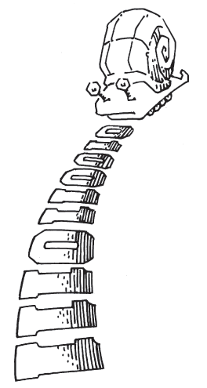
Moore vs. Mealy FSM
Alyssa P. Hacker has a snail that crawls down a paper tape with 1’s and 0’s on it. The snail smiles whenever the last two digits it has crawled over are 01. Design Moore and Mealy FSMs of the snail’s brain.

Slide 41
State Transition Diagrams
Mealy FSM: arcs indicate input/output

Slide 42
Moore FSM State Transition Table
State | Encoding
S0 | 00
S1 | 01
S2 | 10
Current State |  | Inputs | Next State
S₁ | S₀ | A | S'₁ | S'₀
0 | 0 | 0 | 0 | 1
0 | 0 | 1 | 0 | 0
0 | 1 | 0 | 0 | 1
0 | 1 | 1 | 1 | 0
1 | 0 | 0 | 0 | 1
1 | 0 | 1 | 0 | 0
S₁’ = S₀A
S₀’ = A

Slide 43
Moore FSM Output Table
Current State |  | Output
S₁ | S₀ | Y
0 | 0 | 0
0 | 1 | 0
1 | 0 | 1
Y = S₁

Slide 44
Mealy FSM State Transition & Output Table
Current State | Input | Next State | Output
S₀ | A | S'₀ | Y
0 | 0 | 1 | 0
0 | 1 | 0 | 0
1 | 0 | 1 | 0
1 | 1 | 0 | 1
State | Encoding
S0 | 0
S1 | 1
S₀’ = A
Y = S₀ A

Slide 45
Moore Mealy

Slide 46
Moore & Mealy Timing Diagram

Slide 47
FSM Design Procedure
Identify inputs and outputs
Sketch state transition diagram
Write state transition table
Select state encodings
For Moore machine:
Rewrite state transition table with state encodings
Write output table
5. For a Mealy machine:
Rewrite combined state transition and output table with state encodings
6. Write Boolean equations for next state and output logic
7. Sketch the circuit schematic

Slide 48
Chapter 3
Digital Design and Computer Architecture: ARM® Edition
Sarah L. Harris and David Money Harris

